Slide 1
Introduction to Machine Learning (2b)
Rex W. Douglass
Institute for Political Methodology (IPM) 2018

Slide 2
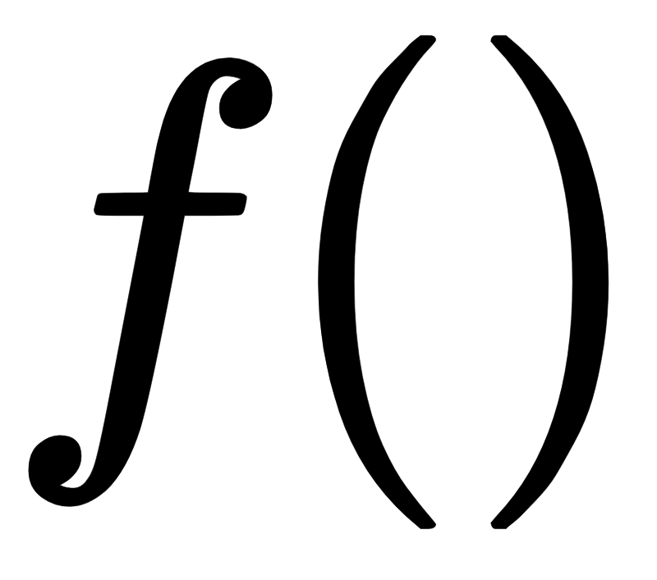
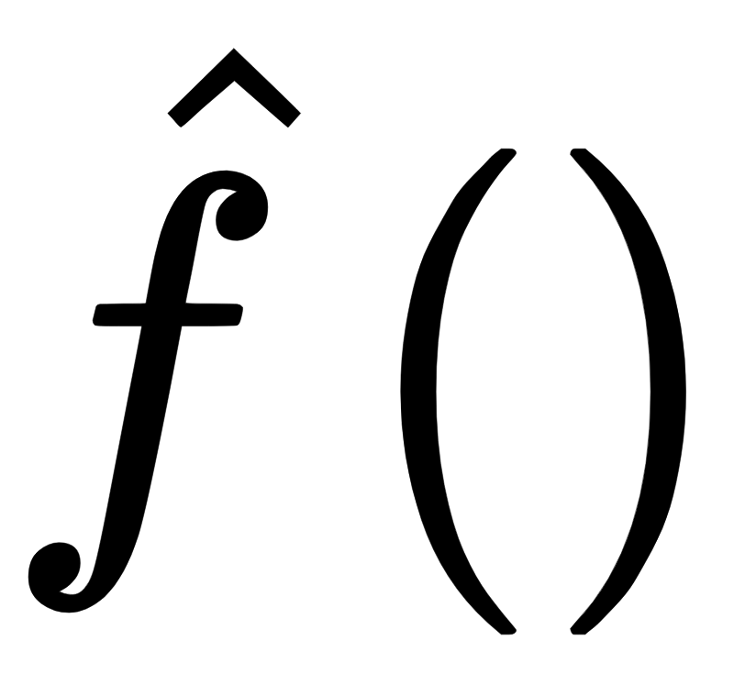


Supervised Learning, Unsupervised Learning, and Engineering
The job is always to build a
that produces accurate
What varies is how many details we get to see beforehand
Do we ever get to examine the true ground state ?
Do we ever get to examine the actual transmitter ?
 |  | Can see
 |  | Yes | No
Can see | Yes | Engineering | Supervised Learning
 | No | Engineering | Unsupervised Learning

Slide 3
Lecture 2B
What if we never see Y?

Slide 4
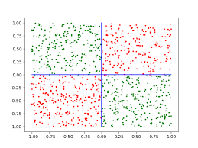
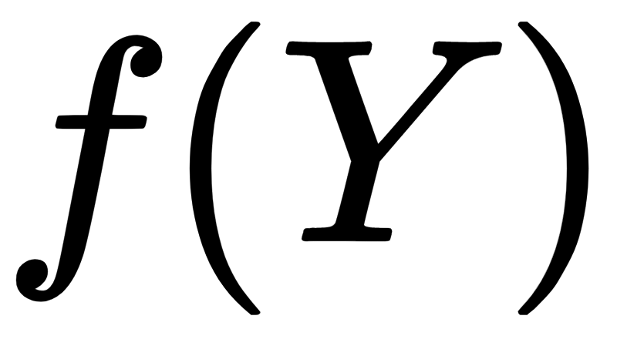
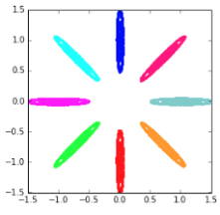
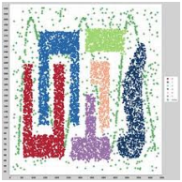
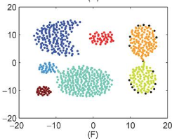
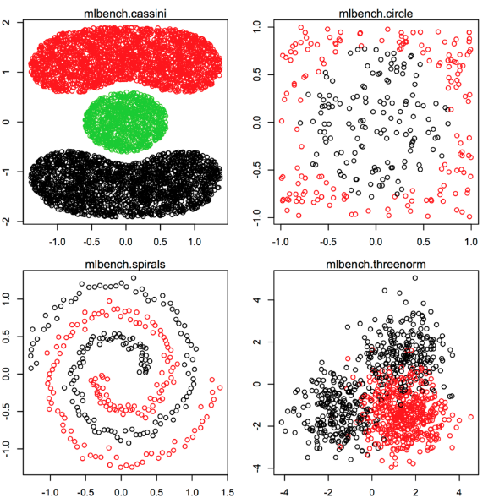
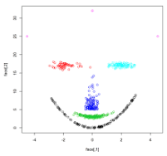
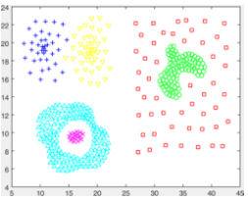
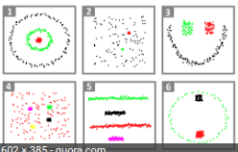
Functions
How weird can this get? (As weird as you can imagine)
Common Toy datasets, with just X and a ground truth labeled

Slide 5
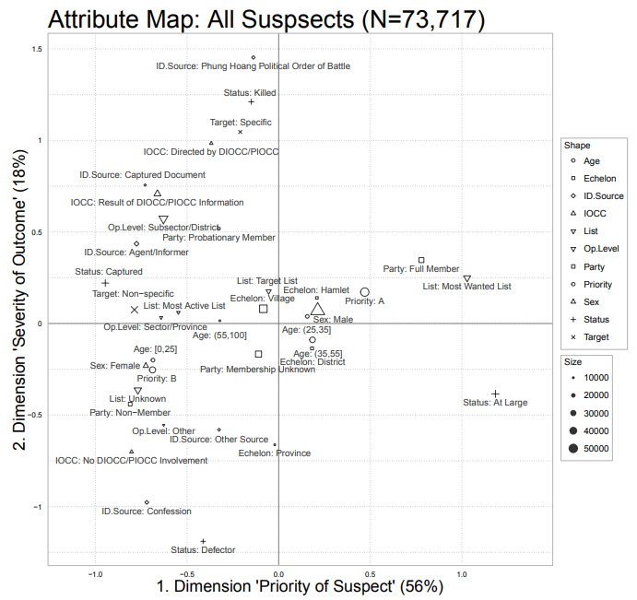
Dimensionality Reduction
Multiple Correspondence Analysis (MCA)
Assume many categorical outcomes are generated by smaller number of continuous latent traits
Civilian Targeting Vietnam War (Douglass 2015)
73k Suspects/Victims
Intelligence files 11 features, with dozens of values
Project into two dimensions and interpret
1 Priority of the Suspect
Low level logistical support versus most wanted guerrilla leaders
2 Severity of the Outcome
Defection, to captures, to killings

Slide 6
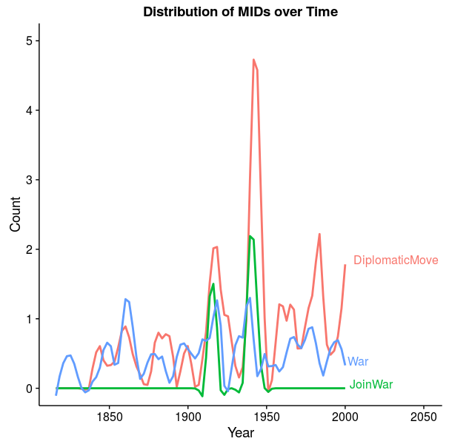
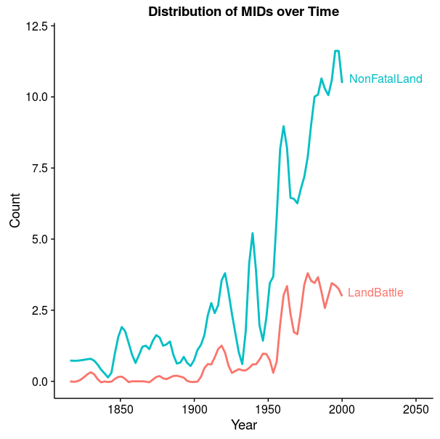
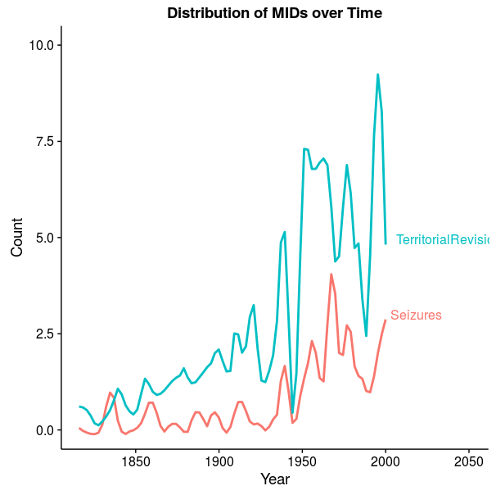
Clustering
Popular conflict dataset: Militarized Interstate Disputes
Unsupervised clustering reveals 7 different types of events
Four of those mechanically increase in time with news reporting

Slide 7
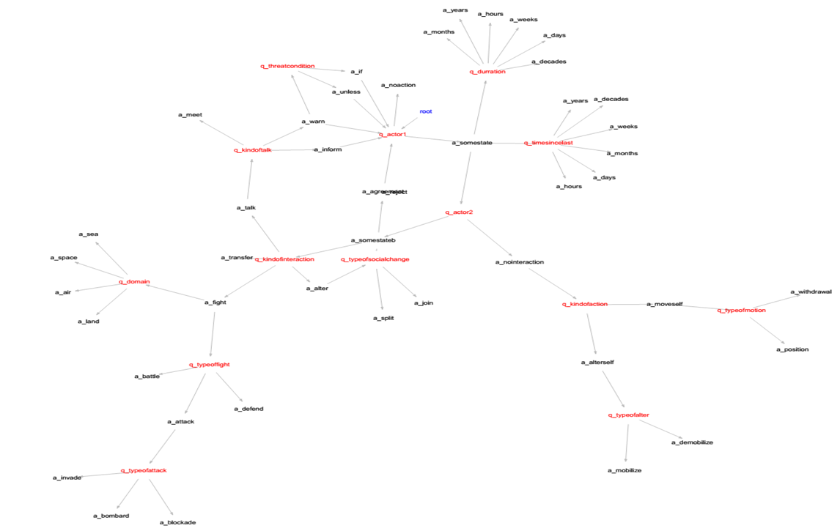
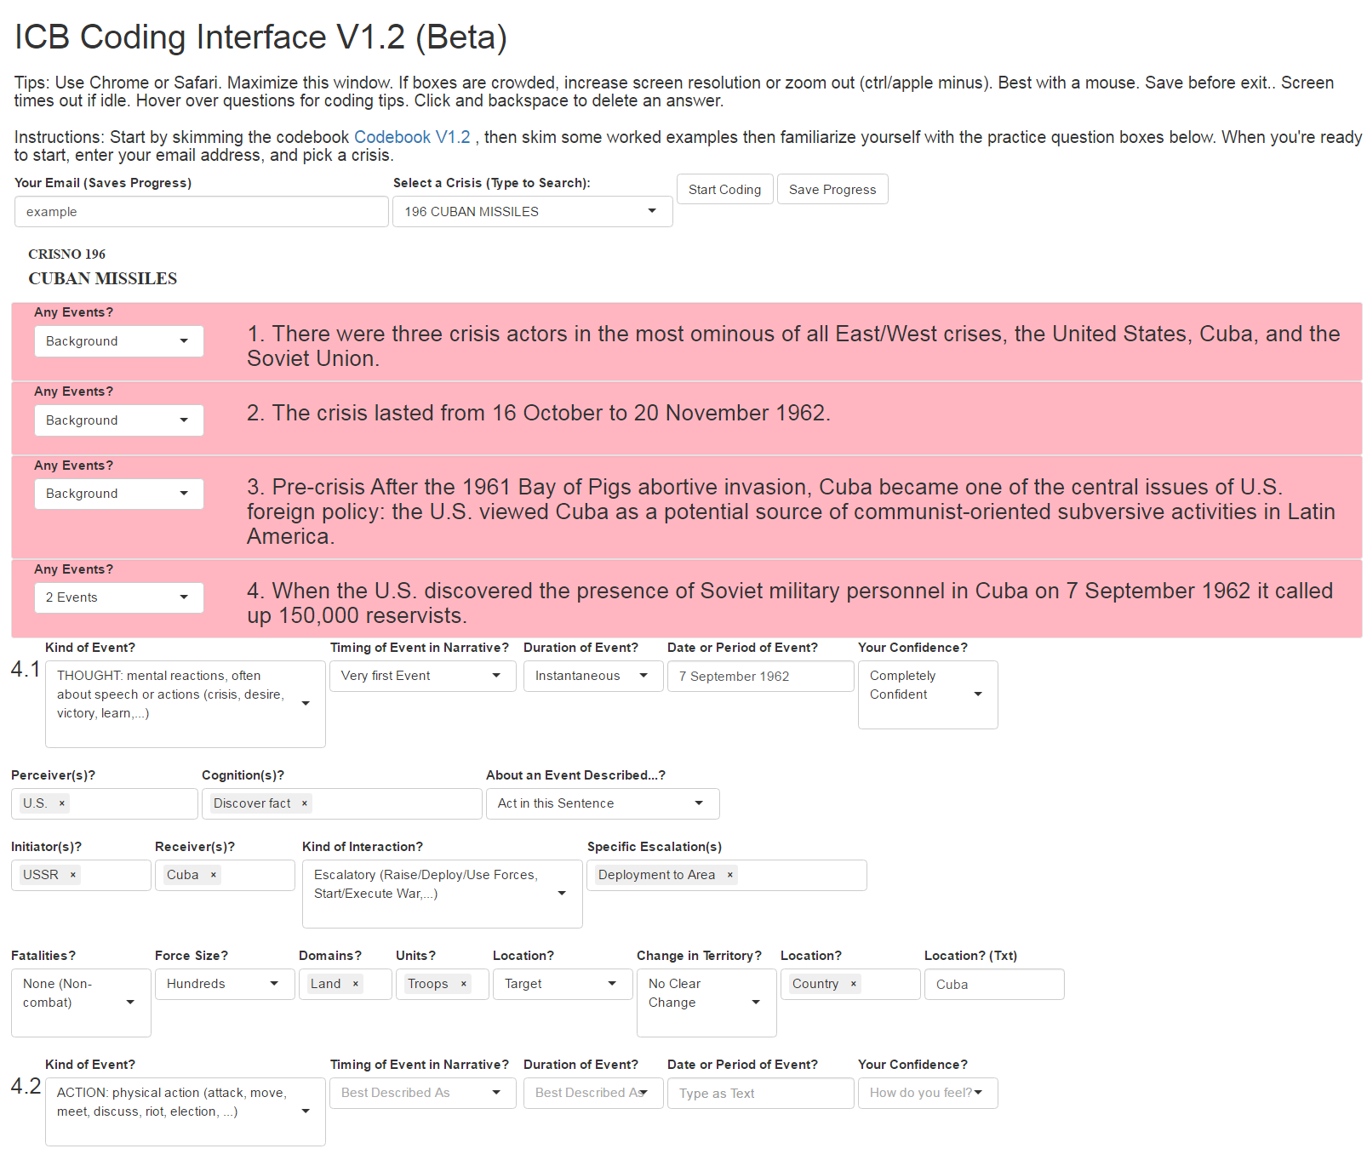

Learn the Sequencing of Actions and Reactions
New ontology for international conflict
Corpus of 470 historical crises, coded sentence by sentence, by multiple graduate and undergraduate coders per sentence

Slide 8
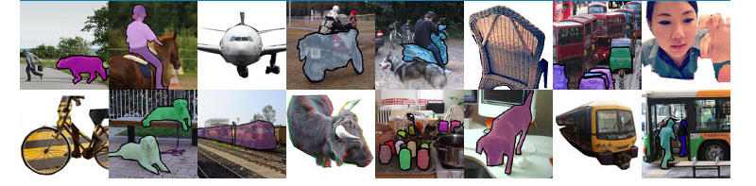


Slide 9
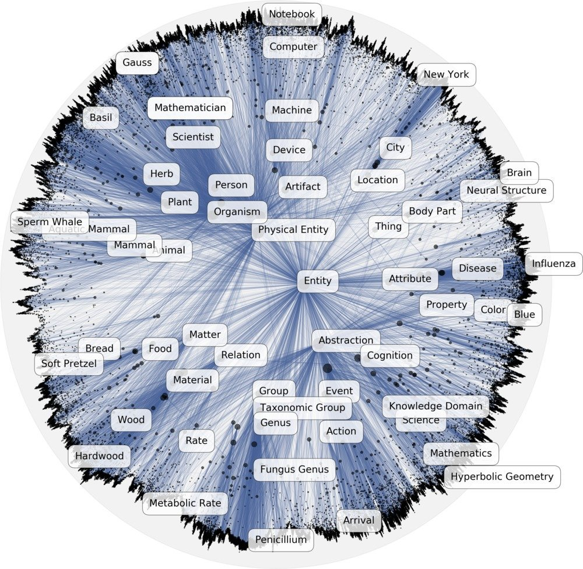
https://github.com/facebookresearch/poincare-embeddings

Slide 10
